Slide 1
Sentiment Decider
Class Lecture / Discussion

Slide 2
Topics From This Unit
Ground Truth Problem
Mechanical Turk + The Hidden Labor Force Driving AI
“Gaming” an algorithm
Recommender Systems: Ranking + Producer Fairness
Binary Classification
Making Assumptions
Discussion Points From The Sentiment Decider Activity

Slide 3
Ground Truth Problem
For certain machine learning models to work, we need labelled data.
Who labels the data? Usually Mechanical Turkers
For example: Who decided what words are “positive” and what words are “negative” for our sentiment analysis algorithm?
Who’s truth is the ground truth?

Slide 4
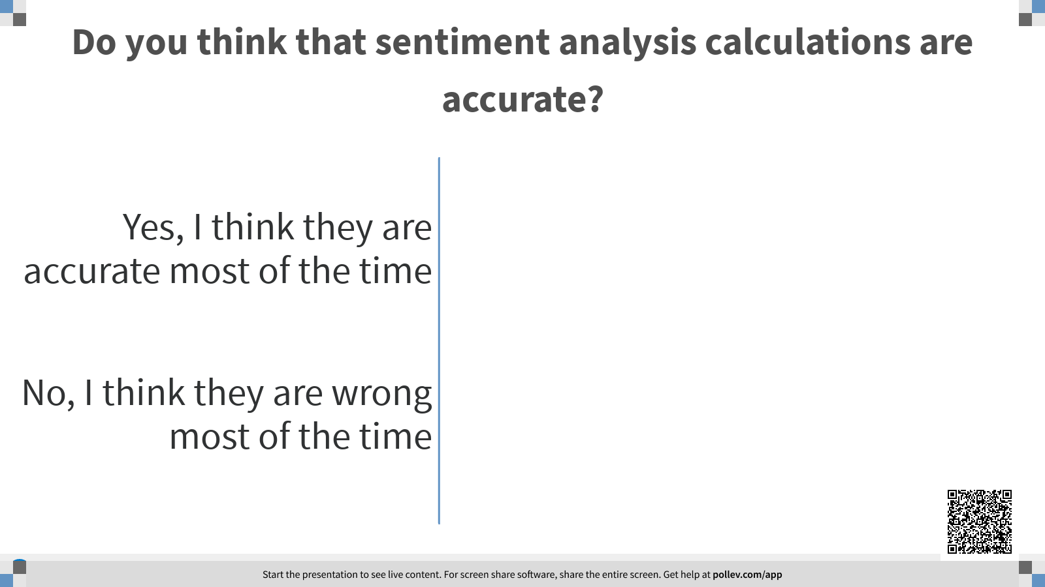

Slide 5
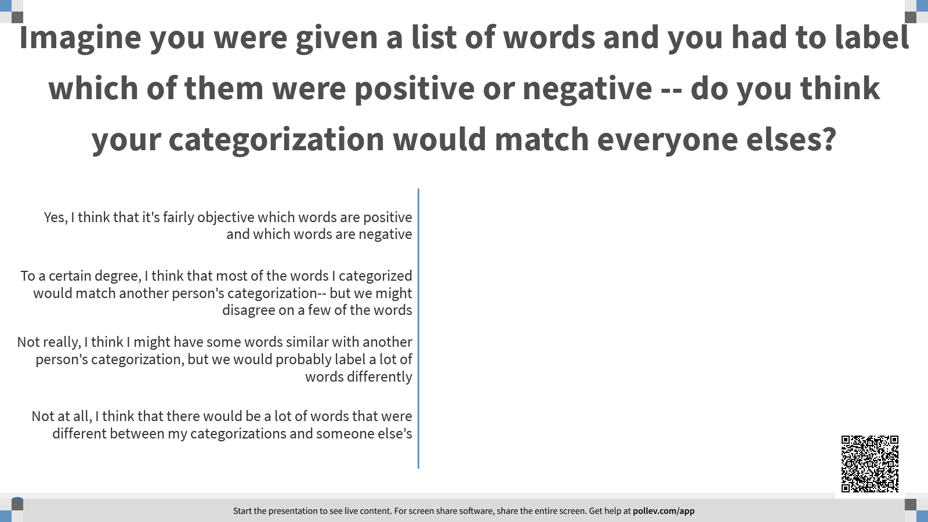

Slide 6
Gaming an Algorithm
Who listened to The Magic Store podcast episode by Reply All?
What does it mean to “game” an algorithm?
What are ways that people have “gamed” Amazon’s algorithm? Can you think of any other algorithms that people probably “game”?
When you figure out how it works… you can exploit it!
Notes:
Other algorithms that people game:
YouTube
Instagram - even using the feature to hide your hashtags could be considered a rudimentary version of “gaming the algorithm”
Twitter trending list
Itunes (I’ve done this)

Slide 7
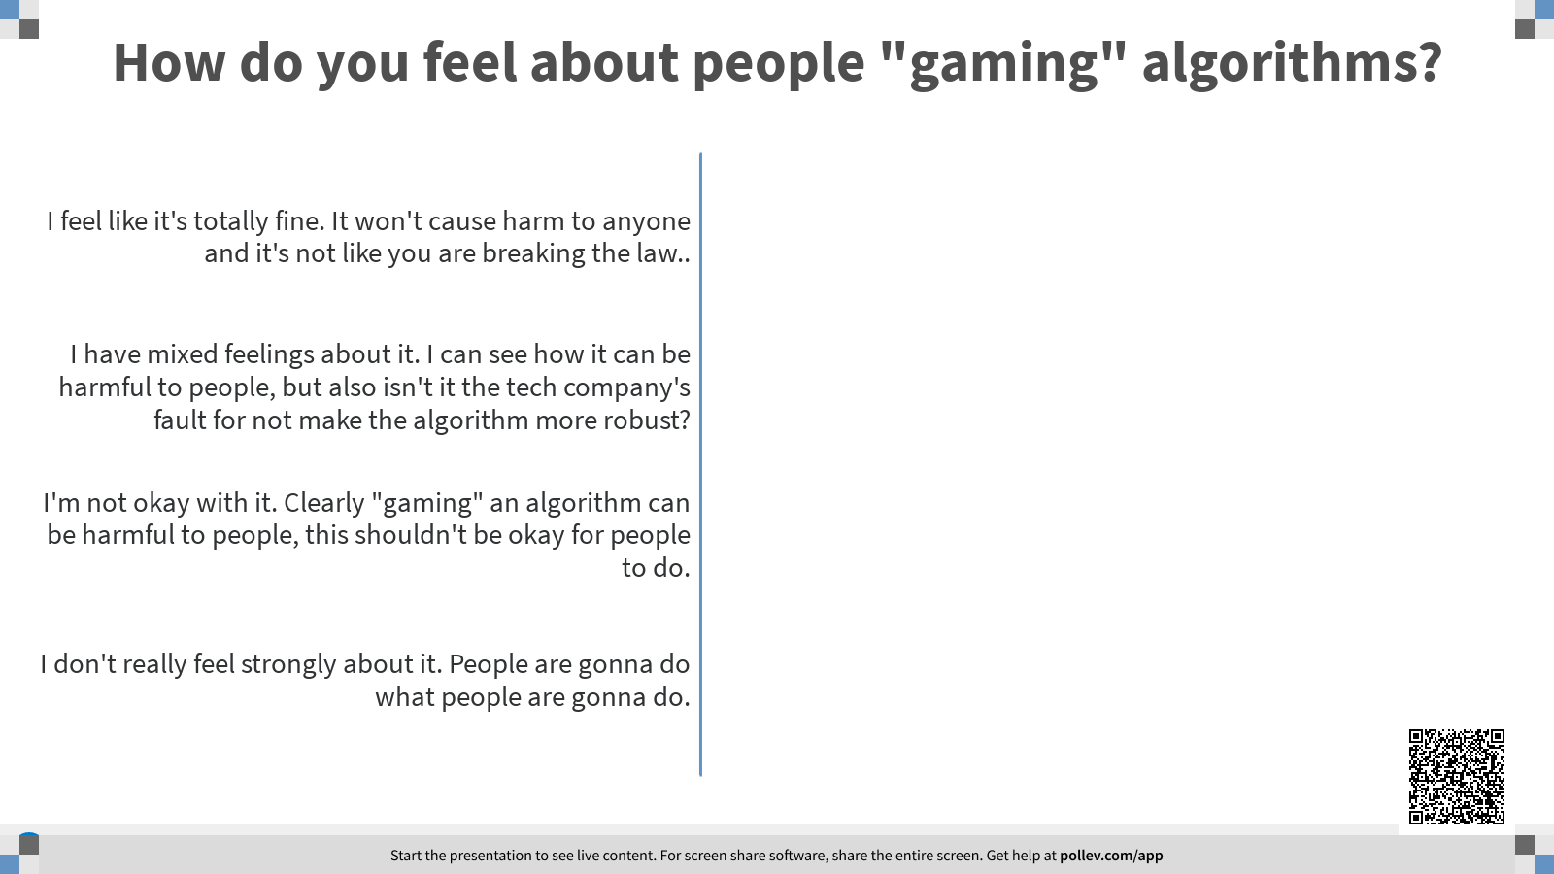

Slide 8
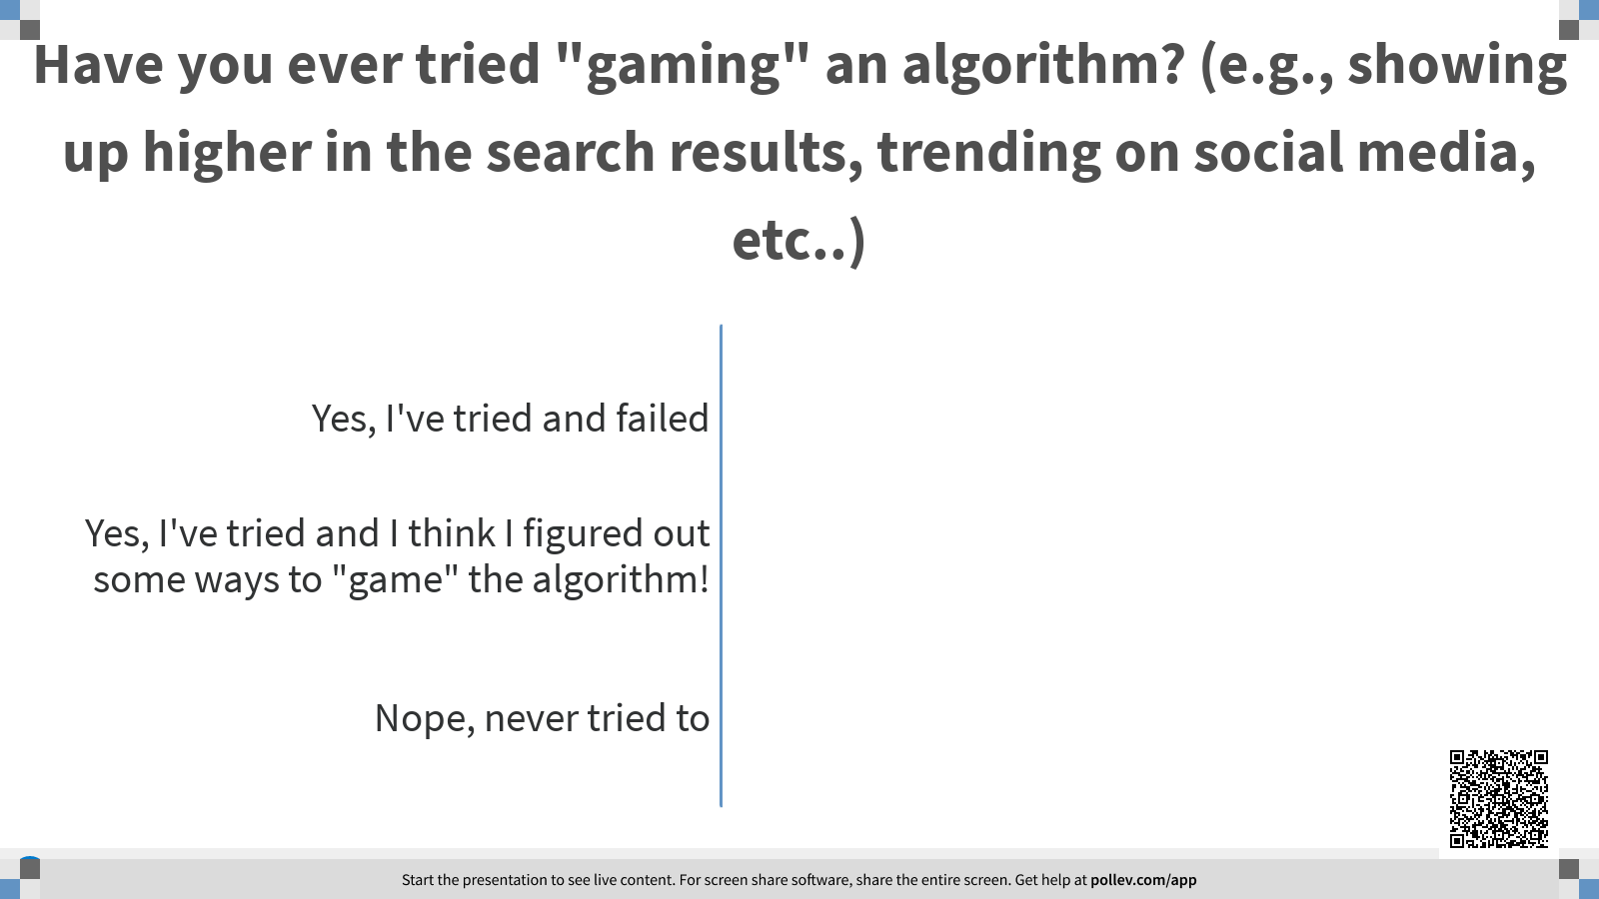

Slide 9
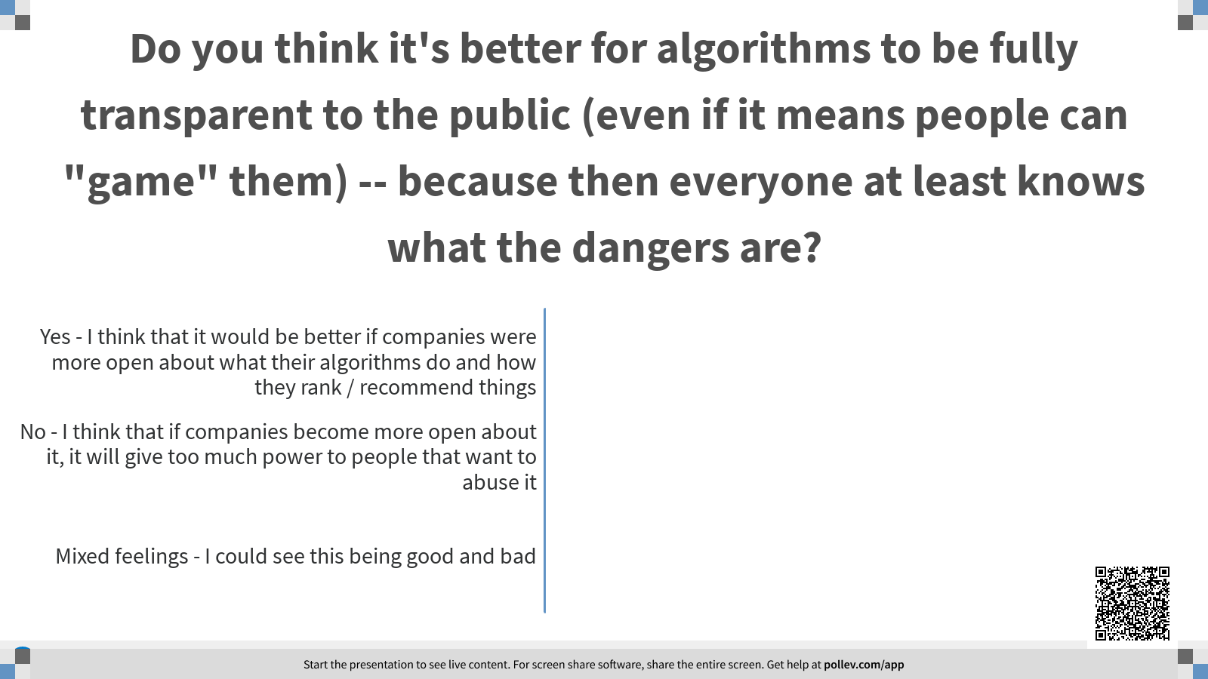

Slide 10
Recommender Systems
What is a recommender system?
How does ranking work?
What does it mean for recommendations to be fair to producers?
Ranking + Producer Fairness

Slide 11
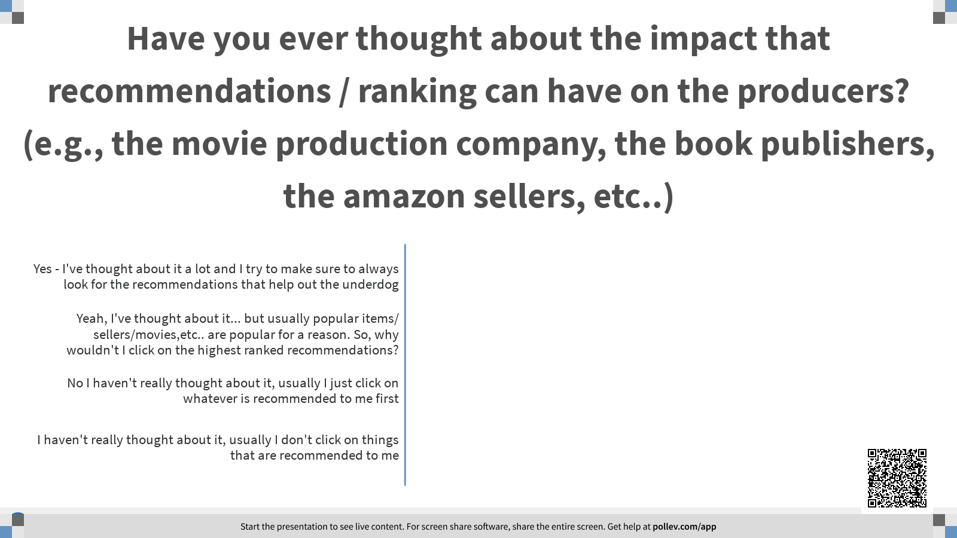

Slide 12
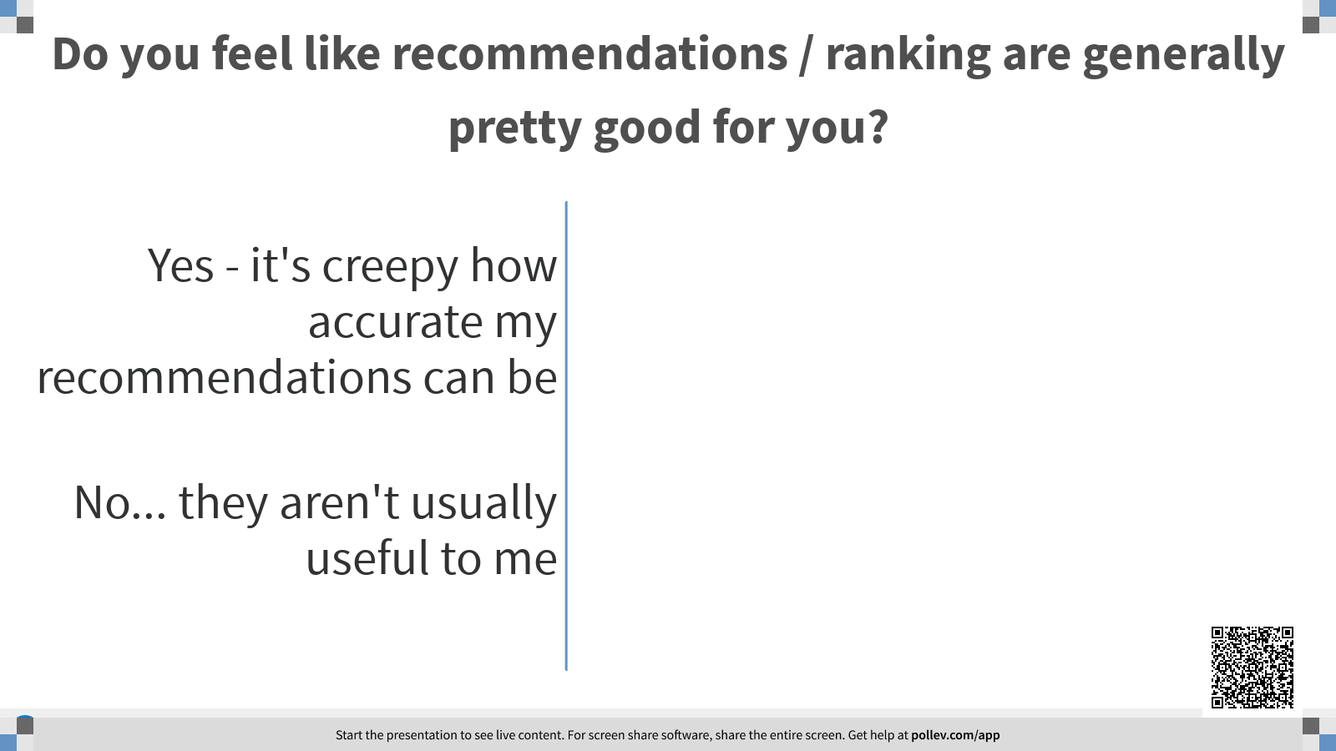

Slide 13
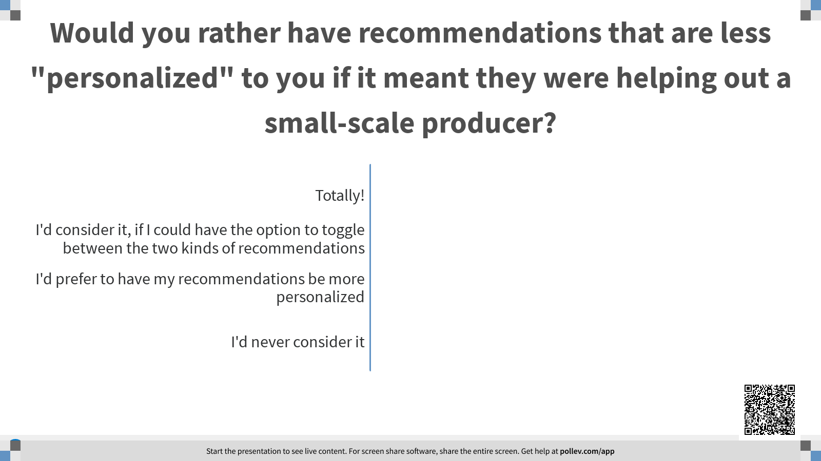

Slide 14
Binary Classification
What is binary classification? How can this be good/bad?
Can anyone think of an example where our sentiment analyzer could have been really inaccurate? How could we resolve these problems?
What are some assumptions we made in our sentiment decider?
Making Assumptions
Notes:
Inaccurate sentiment analyzer: If we had a sentiment really close to 0.5 (e.g. 0.500001 or 0.499999) - it would basically be neutral, but it would be categorized as “positive” or “negative”. We could resolve these problems by having more options between positive and negative. Also many people usually assume that a bigger range is “neutral” when it comes to sentiment analysis: ie) 0.4-0.6 is neutral. (and also usually the number is from -1 to 1 so the range of -0.5 to 0.5 can even be seen as neutral.
Assumptions: that all of the negative and positive words were accurate and a “ground truth” and that only a number of 0.5 was neutral.

Slide 15
